Slide 1
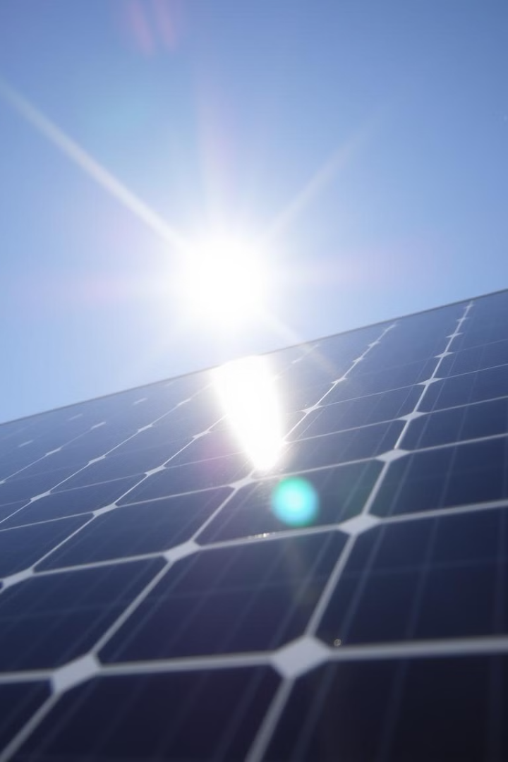
Solar Energy Maximization Tracker
This presentation explores solar sun tracking systems, delving into the technology, benefits, and future advancements that are revolutionizing solar energy.
Y.YAMINI REDDY 192211153
G.SHREENIDHI 192211161

Slide 2
Introduction to Solar Energy
Solar energy harnesses the sun's power, converting light into electricity. It's a clean, renewable resource that can help mitigate climate change.
Solar panels, also known as photovoltaic panels, are the core of a solar energy system. These panels contain semiconductor materials that absorb sunlight and generate electrons, resulting in an electric current.

Slide 3
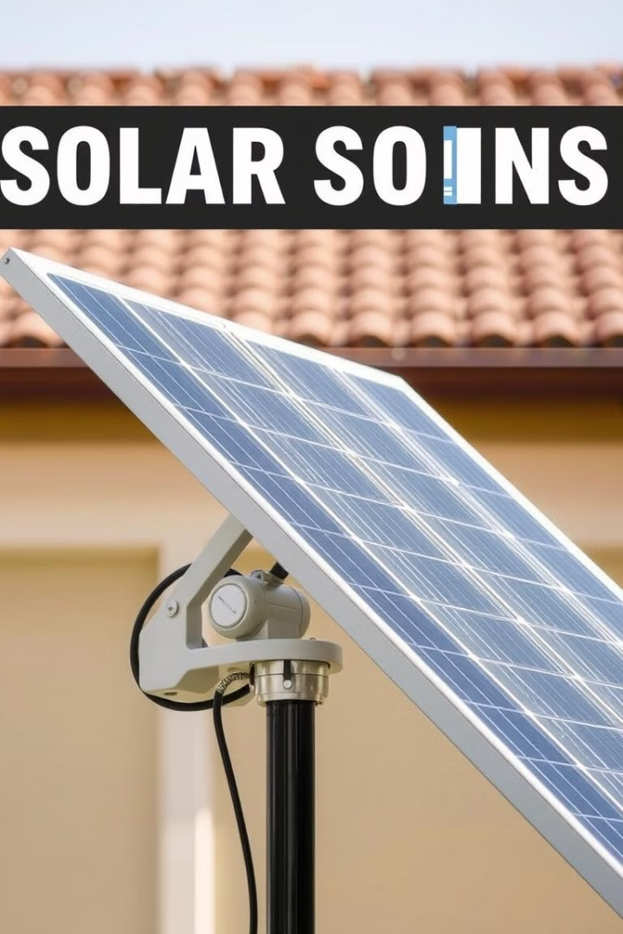
Importance of Solar Tracking
1
Increased Efficiency
2
Enhanced Power Output
Solar tracking optimizes the angle of the solar panels to capture the maximum amount of sunlight throughout the day.
By maximizing sunlight exposure, solar tracking systems can boost energy production by up to 40% compared to fixed panels.
3
Reduced Costs
Increased energy output translates to lower electricity costs, making solar tracking a cost-effective investment.

Slide 4

Types of Solar Tracking Systems
Single-Axis
Dual-Axis
These systems rotate along one axis, typically north-south, to follow the sun's movement across the sky.
Dual-axis systems rotate on two axes, allowing them to track the sun's position more precisely throughout the day.

Slide 5



Single-Axis Tracking Systems
Horizontal
1
Rotates horizontally along a north-south axis.
Vertical
2
Rotates vertically along an east-west axis.
Polar
3
Tracks the sun's path across the sky at a fixed angle.

Slide 6
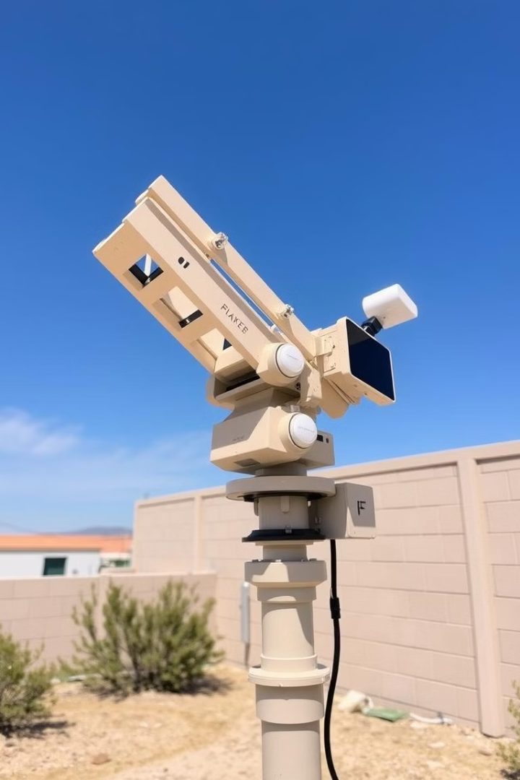



Dual-Axis Tracking Systems
Azimuthal
Rotates horizontally to follow the sun's east-west movement.
Elevation
Rotates vertically to adjust the angle of the panels based on the sun's altitude.
Combined
Combines azimuthal and elevation movements for optimal tracking.

Slide 7
Hardware Components
Solar panels convert sunlight into electricity.
1
2
Motors drive the movement of the tracking system.
Sensors monitor the sun's position and adjust panel angles.
3
4
Control units process sensor data and direct motor actions.
Supporting structures hold and stabilize the system.
5

Slide 8
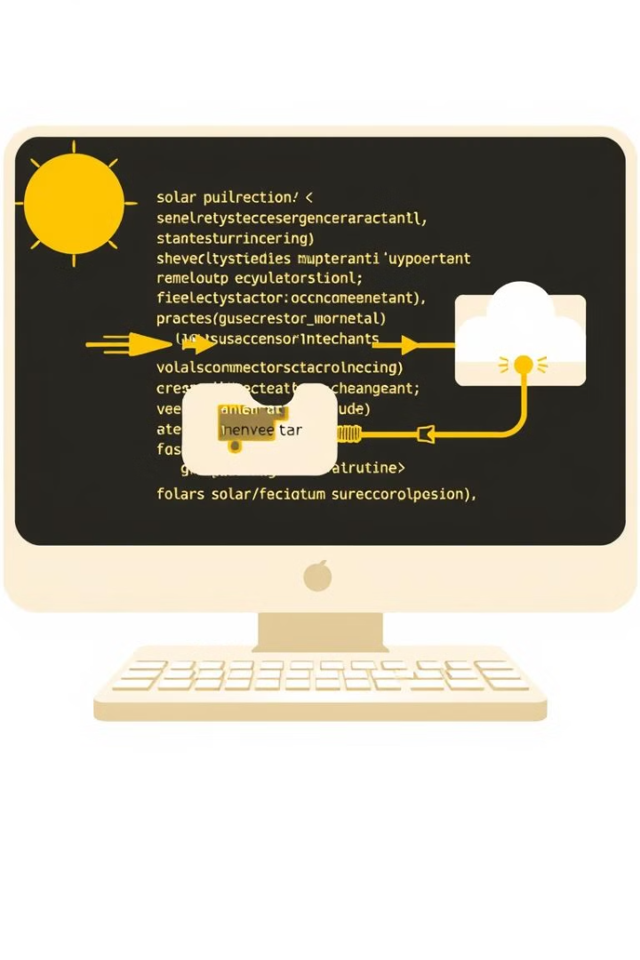



Software Components
Tracking algorithms analyze sun position data and calculate optimal panel angles.
Control software manages the system's operations, ensuring smooth and accurate tracking.
Data acquisition and analysis modules collect and process system performance data.

Slide 9
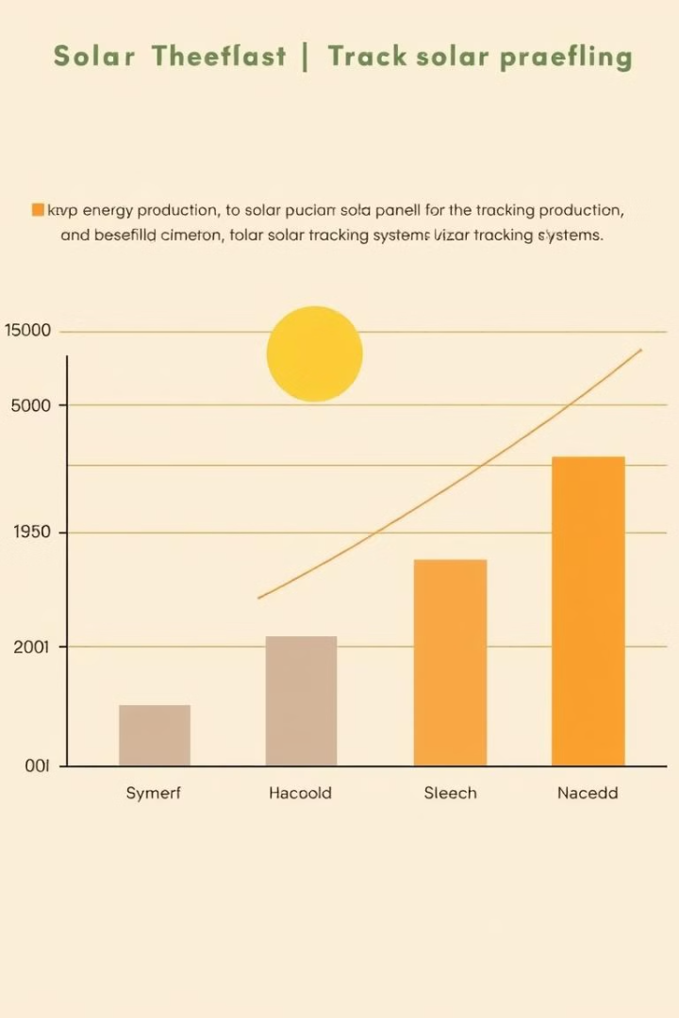
Benefits of Solar Tracking
40%
Energy Boost
Higher energy output translates to significant cost savings.
25%
Reduced Costs
Solar tracking optimizes energy production, lowering electricity bills.
15%
Lower Emissions
Greater efficiency reduces the need for fossil fuels, promoting sustainability.

Slide 10

Future Advancements in Solar Tracking
The future of solar tracking promises advancements in artificial intelligence, robotics, and sensor technologies, leading to even greater efficiency and cost-effectiveness.

